Slide 1

Final Group Project -
Group A
Akanksha Upadhyay
Hale Muge Ucar
Kazuki Saito
Rojan Omarzadeh

Slide 2
CONTENT
1
Introduction
2
Task 1
3
Task 2
content
Text Mining
Text Classification Text Clustering Sentiment Analysis
Data loading
Sanity Checks
Initial Visualizations
Sentiment Classification
Word Clouds
4
Task 3
5
Wrap up
logistic regression
multinomial logistic regression

Slide 3
Introduction:
This project aims to showcase advanced proficiency in text mining, particularly focusing on sentiment analysis using Python. The dataset comprises two detailed files containing information on 212,404 unique books available on Amazon from 1996 to 2014. With a vast dataset of 142.8 million reviews spanning May 1996 to July 2014, this project provides a substantial textual resource.
The structured data is divided into two main files: one concentrating on reviews, encompassing critical details such as book ID, title, price, user information, and the review content; the other file delving into comprehensive book details, including title, description, authors, cover image URLs, and additional pertinent information.
Throughout the project, the goal is to extract meaningful insights from this extensive textual dataset, utilizing various text mining techniques, with a specific emphasis on sentiment analysis using the Python programming language.
To accomplish the stated objective, the entire project is segmented into three tasks:
1.Conceptual Understanding: Our initial focus is on acquiring a solid grasp of the fundamental concepts essential to text mining. We will delve into the basics of text mining, exploring the nuances of text classification, text clustering, and sentiment analysis. By establishing a robust understanding of these concepts, we set the stage for the subsequent phases of our project.
2.Practical Applications and Data Exploration: Next, we will put our knowledge into action with real-world data. Tasks include data cleansing to ensure organized information, classifying reviews into positive and negative sentiments, and generating meaningful visualizations like word clouds. This phase aims to enhance our understanding of the reviews' content through practical applications.
3.Predictive Modeling: The final task centers around prediction. Armed with a solid conceptual foundation and insights drawn from the data, we will construct and assess logistic regression models. These models will predict sentiment categories, distinguishing between positive and negative reviews, and forecast book ratings based on the text-based reviews. This predictive phase aims to demonstrate the practical utilization of our text mining skills, extracting valuable insights from the extensive collection of reviews and book details.

Slide 4
Vi
Text Mining
Definition
Text mining is a process of extracting useful information and nontrivial patterns from a large volume of text databases. it is a component of data mining that deals specifically with unstructured text data. There exist various strategies and devices to mine the text and find important data for the prediction and decision-making process. This allows organizations to gain insights from a wide range of data sources, such as customer feedback, social media posts, and news articles. It involves the use of natural language processing(NLP) techniques to extract useful information and insights from large amount of data.
Process
Gather unstructured information from various sources (plain text, web pages, PDFs).
Perform pre-processing and data cleansing to address inconsistencies.
Eliminate stop words and apply stemming for genuine text extraction.
Implement processing and refining tasks for dataset improvement.
Utilize pattern analysis in Management Information System(identifying pattern or correlation in pre-processed data)
Extract important data for decision-making and trend analysis.
Common Methods for Analyzing Text Mining:
Text Summarization: To extract its partial content and reflect its whole content automatically.
Text Categorization: To assign a category to the text among categories predefined by users.
Text Clustering: To segment texts into several clusters, depending on the substantial relevance.
Notes:
Process explained:
Gathering Unstructured Information:
Collect data from diverse sources such as plain text documents, web pages, and PDFs.
Pre-processing and Data Cleansing:
Address inconsistencies in the data, such as formatting issues, missing values, or duplicate entries and outliers.
Stop Words Elimination and Stemming:
Remove common stop words (e.g., "the," "and," "is") that don't contribute much to the meaning of the text.
Apply stemming to reduce words to their root form, helping to consolidate variations of a word. For example, "siting" and "sat" would both be stemmed to "sit."
Processing and Refining Tasks:
Implement techniques such as tokenization to break down text into individual words or phrases.
Use part-of-speech tagging to identify the grammatical structure of each word.
Apply named entity recognition to identify and categorize entities like people, organizations, or locations.
Utilizing Pattern Analysis in MIS (Management Information System):
pattern analysis techniques, such as machine learning algorithms, to identify trends, correlations, and patterns within the pre-processed data.
Extracting Important Data for Decision-making and Trend Analysis:
Identify key performance indicators (KPIs) or metrics relevant to the specific goals of your analysis.
Extract and analyze relevant data to support decision-making processes.

Slide 5
Vi
Text Mining Contd...
Usage of Text mining:
Customer Service:
Automates text analysis for categorizing and prioritizing customer requests based on topics, intent, complexity, and language.
Improves efficiency by allowing agents to focus on critical tasks, enhancing user satisfaction.
Analyzes customer feedback from diverse sources (e.g., product reviews, social media) to understand opinions and expectations.
Healthcare:
Facilitates researchers by automating information extraction from medical books.
Saves time and resources, proving invaluable for the medical and healthcare community.
Cybersecurity:
Utilizes text analysis to automatically detect and filter spam in email boxes.
Drastically reduces the risk of cyber attacks, improving overall cybersecurity and enhancing user experience.
Social Media Monitoring:
Companies and organizations use text mining to monitor social media platforms for mentions, sentiments, and trends related to their brand, products, or industry.
Information Retrieval:
Text mining is used in search engines to improve the relevance of search results by analyzing and understanding the content of documents.

Slide 6
Vi
Text Classification
Text classification is a machine learning approach that involves assigning predefined categories to unstructured text data. This technique is employed to organize, categorize, and structure diverse textual information, ranging from documents and medical studies to files and online content.Text classification is very useful while analyzing historical data such as in understanding the evolution of sentiments, topics, or themes over time., but it can also be used for real time textual input analysis such as applications like chatbots or customer support systems, text classification helps in understanding user queries and directing them to appropriate responses or actions without human intervention.
Definition
Process
Training Texts: For the classifier to correctly predict the text classification, it needs to understand the text. So, the Training Texts, with already classified tags, are used to train the model.
Training Module: A training module is created based on the text classifications present in training texts. Once the classifier has attained satisfactory level of accuracy, the training texts then can be used to test the accuracy of the predictions.
Classification Rules: These rules define the texts and the associated tags.
Classification Model: The classifier which can read the texts and use the learned inputs and classify the text.
Classification Module: The model which uses outputs of training module and Classification Rules as inputs and predict the classifications.
Common Methods for Analyzing Text Classification:
Rule based systems: To classify text using a set of handcrafted linguistic rules.
Machine learning based systems: Instead of using handcrafted rules, machine learning classifier learns to make classifications based on past observations.
Hybrid systems: combines a machine learning base classifier with a rule-based system, which helps in improving the accuracy levels.
Notes:
Usage of Text Classification:
Spam Detection:
Classifying emails as spam or non-spam to automatically filter unwanted messages from users' inboxes.
Content Tagging:
Automatically tagging or categorizing content on websites or in content management systems to improve searchability and navigation.
Medical Document Classification:
Categorizing medical records, research articles, or clinical notes to assist in organizing and retrieving healthcare information.
Resume Screening:
Automatically categorizing job applicants' resumes into different job categories based on their skills and experiences.

Slide 7
Vi
Text Clustering
Text clustering is the task of grouping a set of unlabelled texts in such a way that texts in the same cluster are more similar to each other than to those in other clusters. Text clustering algorithms process text and determine if natural clusters (groups) exist in the data.Broadly, clustering can be divided into two groups:
Hard Clustering: This groups items such that each item is assigned to only one cluster. For example, we want to know if a tweet is expressing a positive or negative sentiment.
Soft Clustering: Sometimes we don't need a binary answer. Soft clustering is about grouping items such that an item can belong to multiple clusters.
Definition
Process
Select a suitable distance measure to identify the proximity of two feature vectors.
Use a criterion function that tells us that we have got the best possible cluster and stops further processing.
Then use an algorithm to optimize the criterion function. The algorithms can also refine clusters iteratively after every round of clustering.
Common steps in Text Clustering:
Text pre-processing: Pre-processing removes the noise and makes the dataset easier to work with.
Feature Extraction: Extract features from textual data is calculating the frequency of text in corpus.
Clustering: To segment text in different clusters based on the features extracted.
Notes:
Usage of Text Clustering:
Document Organization:
Grouping similar documents together can help in organizing large sets of unstructured data, making it easier for users to navigate and find relevant information.
Social Media Analysis:
Clustering social media posts, comments, or tweets to identify patterns and trends in user-generated content. This can be valuable for understanding public sentiment, emerging topics, or customer opinions.
News Article Clustering:
Grouping news articles with similar content to provide users with diverse perspectives on a particular topic. This can be beneficial for news aggregators and content recommendation systems.
Email Organization:
Automatically categorizing and organizing emails into clusters based on their content, making it easier for users to manage and prioritize their emails.

Slide 8
Vi
Sentiment Analysis
Definition
Sentiment analysis involves determining whether a given piece of text conveys a positive, negative, or neutral sentiment. The aim of sentiment mining is to analyze people's opinions in a manner beneficial for business growth. This process not only considers polarity (positive, negative, neutral) but also delves into emotions like happiness, sadness, and anger. To achieve this, sentiment analysis employs diverse Natural Language Processing algorithms, including rule-based, automatic, and hybrid approaches.
Process generally involves two main steps: Preprocessing and Analysis.
Preprocessing:
Collecting text data from various sources, such as customer reviews, social media posts, or news articles.
Cleaning and standardizing the data through tasks like:
Removing irrelevant information (e.g., HTML tags, special characters).
Tokenization: Breaking the text into individual words or tokens.
Removing stop words (common words like "and," "the," etc. that don’t contribute much to sentiment).
Stemming or Lemmatization: Reducing words to their root form.
Analysis:
Converting the preprocessed text for analysis using techniques like bag-of-words or word embeddings.
Training models with labeled datasets that associate text with sentiments (positive, negative, or neutral).
After training and validation, the model predicts sentiment on new data by assigning labels based on learned patterns.
Process
Notes:
Usage of Sentimental Analysis:
. Module evaluation survey: commonly used in educational institutions, aim to gather feedback from students about a specific course or module. Sentiment analysis is applied to these surveys to automatically analyze and understand the sentiment expressed in the student's response.
Customer Feedback Analysis:
Analyzing customer reviews, feedback, and comments to understand the overall sentiment towards products, services, or brands. This helps businesses identify areas for improvement and gauge customer satisfaction.
Social Media Monitoring:
Monitoring social media platforms to track and analyze public sentiment about a company, product, or event in real-time. This is crucial for reputation management and brand perception.

Slide 9
Vi
Sentiment Analysis Contd...
Approaches to Sentiment Analysis:
Rule-based Approach:
Utilizes lexicon methods, tokenization, and parsing.
Involves counting positive and negative words in the dataset.
Decision based on the greater count of positive or negative words.
Machine Learning Approach:
Trains datasets using machine learning techniques.
Performs predictive analysis.
Extracts words from text using methods like Naive Bayes, Support Vector Machines, hidden Markov model, and conditional random fields.
Neural Network Approach:
Utilizes artificial neural networks inspired by the human brain's structure.
Employs models like Recurrent Neural Networks, Long Short-Term Memory, Gated Recurrent Unit to process sequential data like text.
Hybrid Approach:
Combines two or more approaches, typically rule-based and machine learning.
Achieves higher accuracy compared to individual approaches.
Leverages the strengths of both rule-based and machine learning methods.

Slide 10
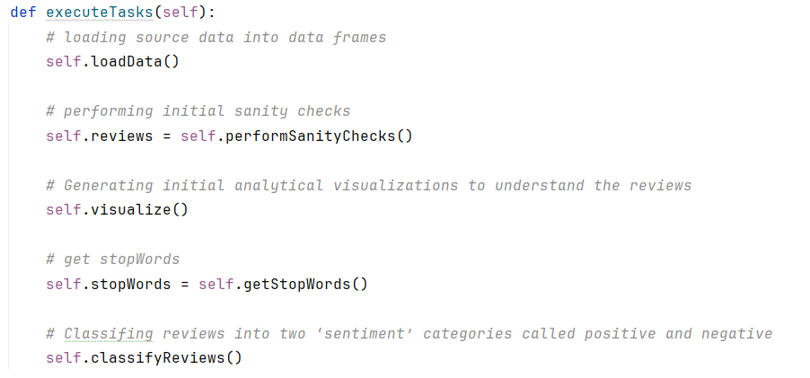
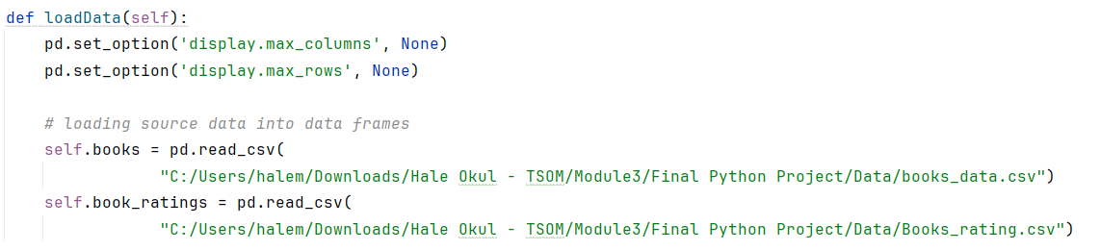
Vi
2-1: Data loading
Notes:
This is the high-level overview of the program's workflow, starting from data loading and preprocessing to visualization, classification, and prediction tasks.
We have loaded book details and reviews into two data frames.

Slide 11
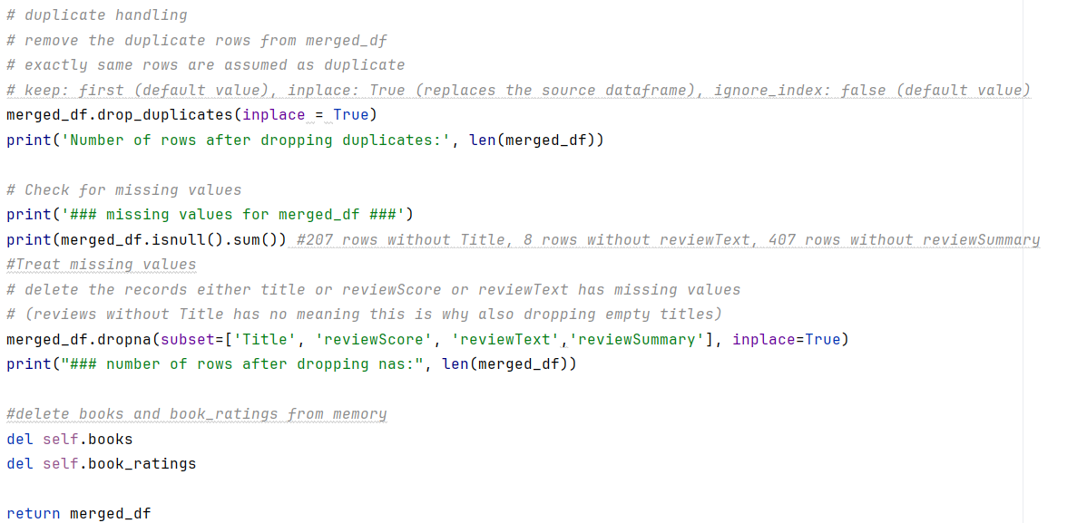
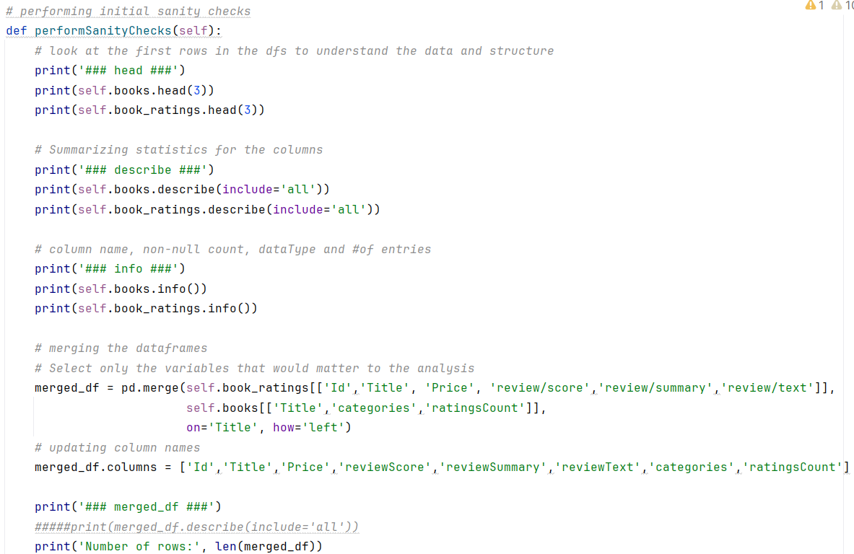
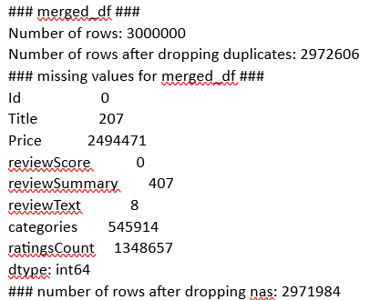
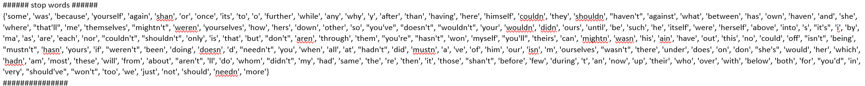
Vi
2-1: Sanity Checks
Notes:
We've performed the initial checks
Looked at the header rows in the data frames
Checked summary statistics of all columns
Columns, data types
Merged the two data frames using Title field and took only the variables that would matter to the analysis
Then we have removed the duplicate rows which is exactly the same rows
Checked the missing values
Dropped the observations which either title or reviewScore or reviewText has missing values
207 rows without title
8 rows without reviewText
407 rows without reviewSummary
In order to release the memory , we have deleted books and ratings
Retrieved the stop words

Slide 12
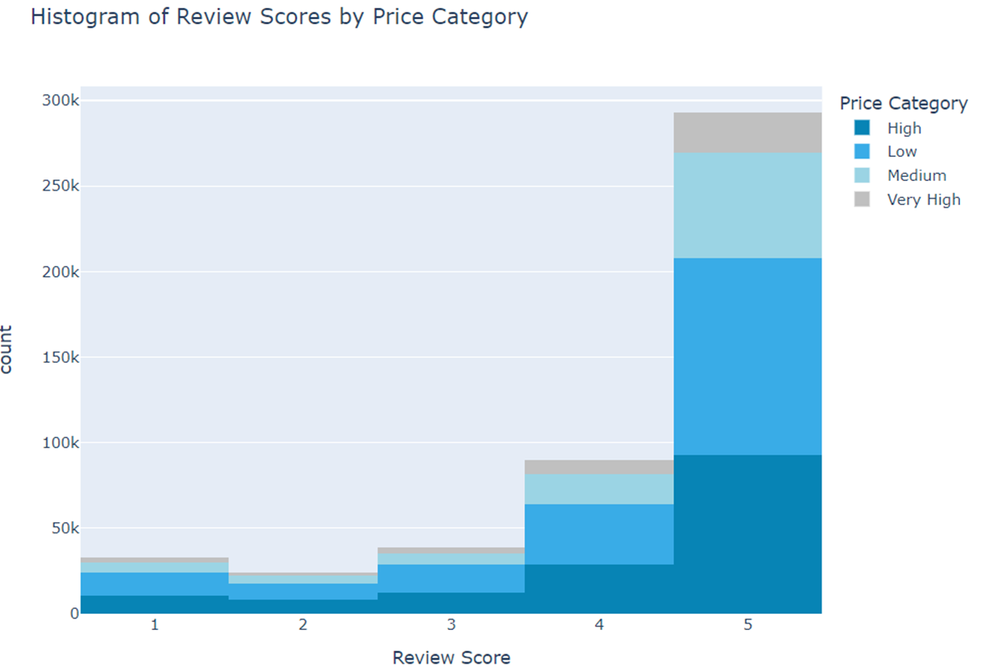
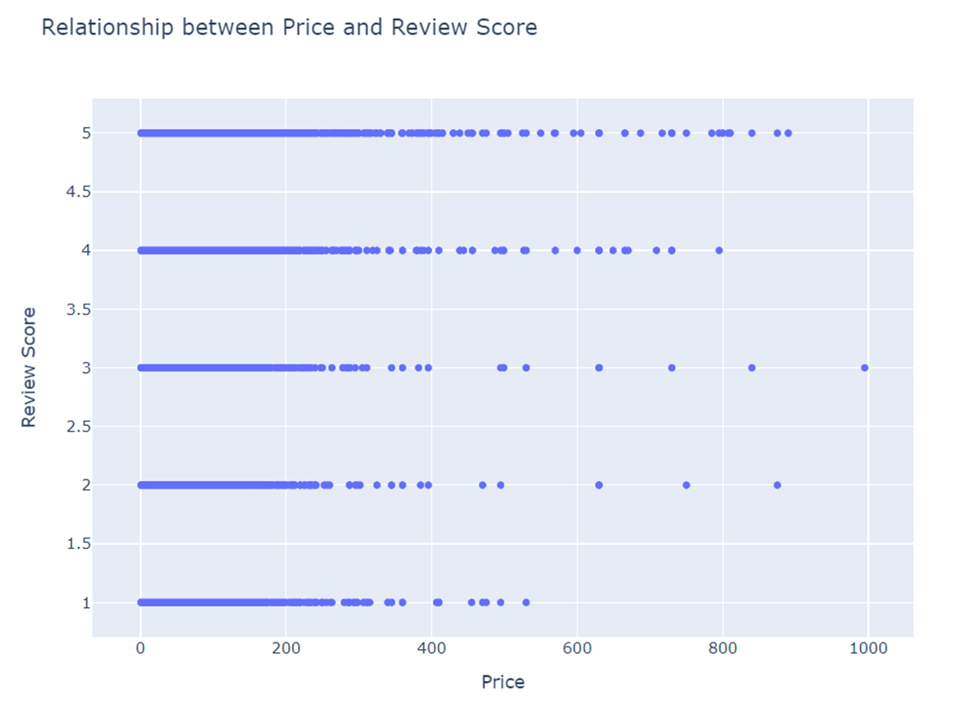
Vi
2-2: Initial Visualizations
Notes:
We have generated initial analytical visualizations to understand the data
In the first graph you can see the histogram of the review scores
Reviews with the higher frequency are from positive reviews (reviews with higher scores)
We have added price category into the data based on price range. You can also see the price category breakdown in the graph.
We have also draw the scatter chart to see the relation btw price and review

Slide 13
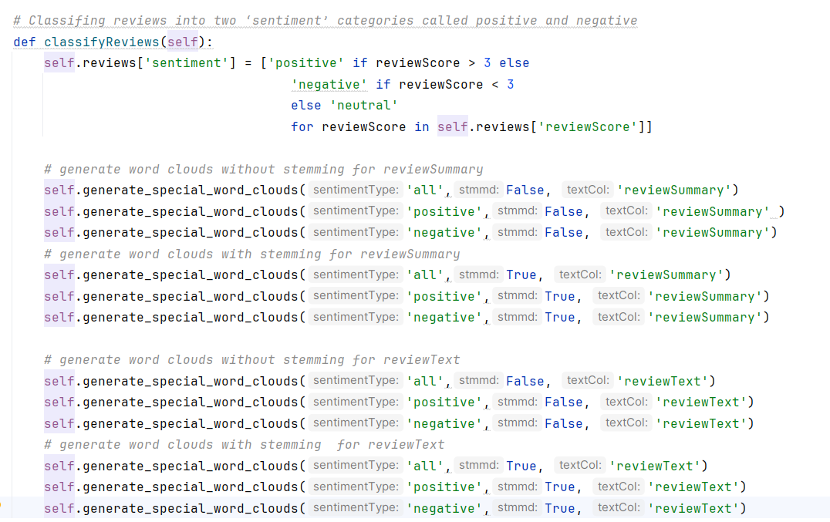
Vi
2-3: Sentiment Classification
Notes:
We have added sentiment into the data frame based on reviewScore . Marked positive if it is more than 3, neutal if it is 3, negative if it is less than 3
Generated word clouds based on the specified sentiment type and text column
Generated 6 word clouds for ReviewSummary and 6 for reviewText
All/positive/negative * stemmed/unstemmed

Slide 14
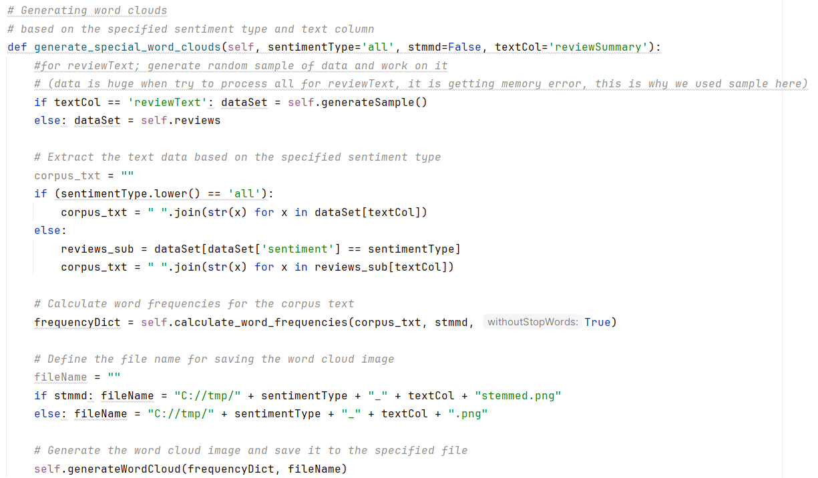
Vi
2-3: Sentiment Classification
Notes:
ReviewText is huge when try to process all for reviewText, it is getting memory error, this is why we used sample here for reviewText
On the other hand we could process reviewSummary as a whole
Once we determine the corpus based on the parameters passed to the function,
Tokenized the text considering stemming and stopWord parameters and then calculated word frequencies
Then generated the word clouds save them to the spesified paths

Slide 15
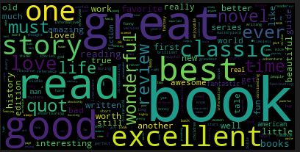
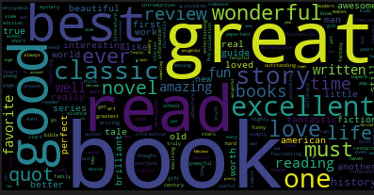
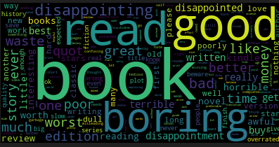
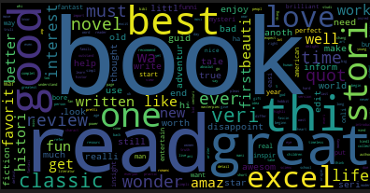
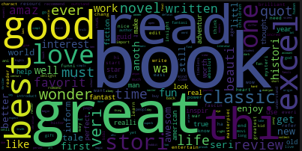
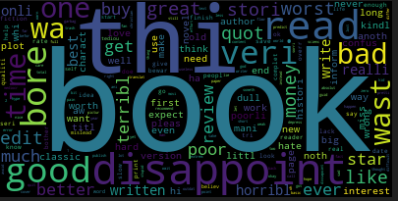
Vi
2-4: Word Clouds - reviewSummary
All
Positive
Negative
Stemmed
Notes:
word clouds provide insights into the commonwords discussed in the book reviews. It helps us understand the overall sentiment of the reviewers and identify key aspects of the books
We can see the words like great, good, best, excellent, wonderful indicating that they are mentioned frequently in positive reviews
In negative reviews, we can see boring, worst, disapointed, disapointing, diapointment, horrible
On the other hand we can also see some positive words like good, great, best here. Most probably they are used with some additional negation suffix like not
When stemming is used we can see that for 3 words related with disapointmen is decreased to one word which is disappoint. However, we can also see that some words are reduced to meaningless root forms like thi, wa
We can see combination of words seen in positive and negative reviews in the word cloud for all

Slide 16
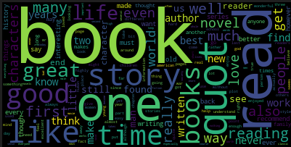
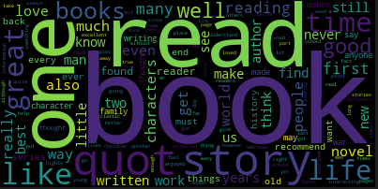
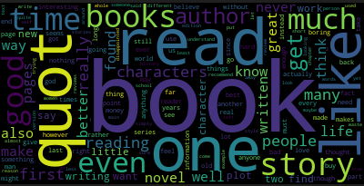
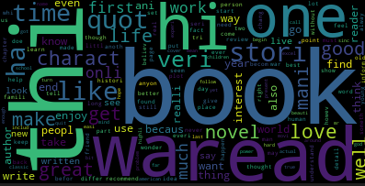
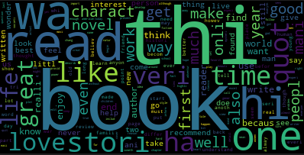
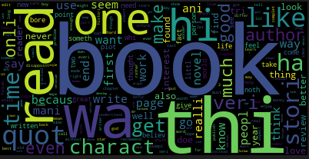
Vi
2-4: Word Clouds - reviewText
All
Positive
Negative
Stemmed
Notes:
key themes or topics discussed in the reviews
significant terms frequently used in the reviews

Slide 17
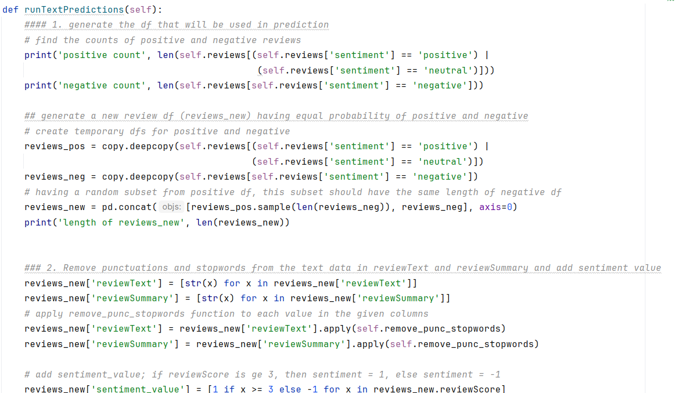
Vi
3-1: Simple logistic regression
Notes:
This part of code performs sentiment analysis using logistic regression and TF-IDF representation.
Count Positive and Negative Reviews:
The code prints the count of positive and negative reviews in the dataset. It filters the reviews based on their sentiment labels ('positive', 'negative', or 'neutral') using boolean indexing and calculates the length of each filtered subset.
Generate New DataFrame with Balanced Sentiments:
It creates a new DataFrame called reviews_new with an equal probability of positive and negative reviews. It first creates temporary DataFrames (reviews_pos and reviews_neg) by filtering positive/neutral and negative reviews, respectively. Then, it samples a random subset of positive reviews with the same length as the negative reviews and concatenates it with the negative reviews.
Text Preprocessing:
It preprocesses the text data by removing punctuation and stopwords from the 'reviewText' and 'reviewSummary' columns of the reviews_new DataFrame. The remove_punc_stopwords function is applied to each value in these columns.
Add Sentiment Value:
It adds a new column 'sentiment_value' to the DataFrame based on the 'reviewScore'. If the review score is greater than or equal to 3, the sentiment value is set to 1 (indicating positive sentiment); otherwise, it is set to -1 (indicating negative sentiment).

Slide 18
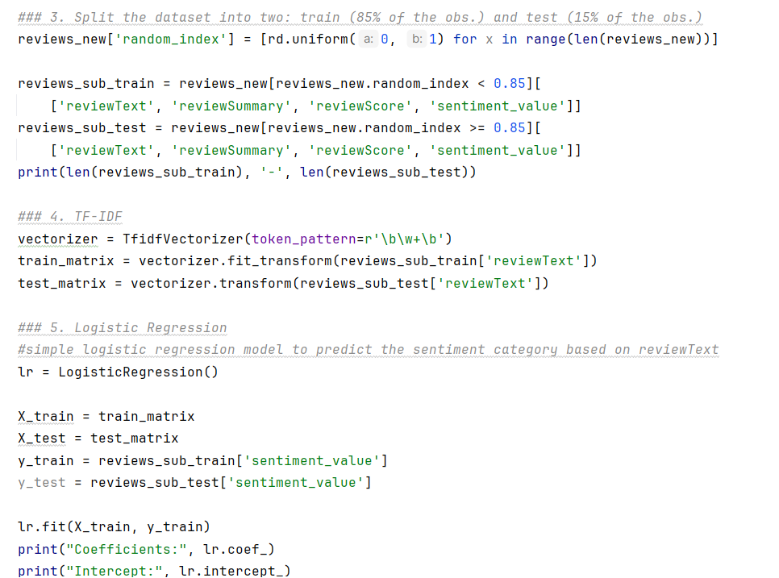
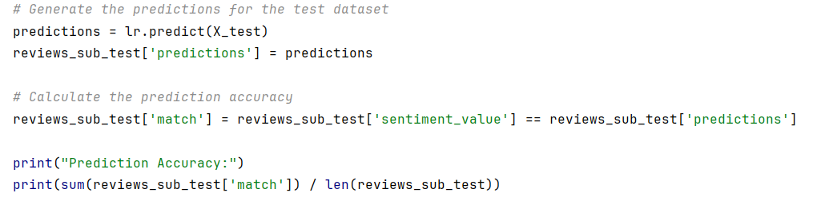
Vi
3-1: Simple logistic regression – cont.
lr1: LogisticRegression()
Prediction Accuracy:
0.8715
Notes:
Split Dataset into Train and Test Sets:
It splits the reviews_new DataFrame into two subsets for training and testing the logistic regression model. Approximately 85% of the observations are used for training (reviews_sub_train), and the remaining 15% are used for testing (reviews_sub_test). The splitting is done randomly using a 'random_index' column generated using uniform random numbers.
TF-IDF Representation:
It transforms the text data into TF-IDF matrices for both the training and testing sets using the TfidfVectorizer from scikit-learn. The 'reviewText' column from both subsets is used to create TF-IDF matrices (train_matrix and test_matrix).
Logistic Regression Model:
It initializes a logistic regression model (lr) and fits it to the training data (X_train and y_train). The model is trained to predict the sentiment category ('sentiment_value') based on the TF-IDF representation of the review text.
Prediction and Evaluation:
It generates predictions for the test dataset (X_test) using the trained logistic regression model. It then calculates the prediction accuracy by comparing the predicted sentiment values with the actual sentiment values. The accuracy is printed as the ratio of the number of correct predictions to the total number of predictions.

Slide 19
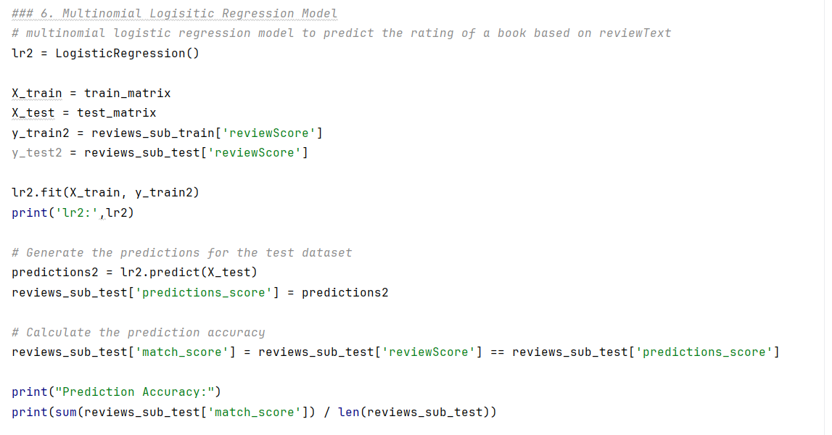
Vi
3-2: Multinomial logistic regression
lr2: LogisticRegression()
Prediction Accuracy:
0.6463918213982586
Notes:
I will talk about a multinomial logistic regression model.
We used this model to predict the rating of a book based on its reviews.
This code is divided into 5 steps. This process is almost the same as simple logistic regression.
Step 1: Data Preparation
The process is the same as the previous model.
Step2 Target Preparation
The process is the same as the previous model.
Step3 Model Training
The logistic regression model is trained using the training data with lr2.fit(X_train, y_train2).
Step4 Generate Predictions
The predictions for the ratings of the books in the test data are generated with lr2.predict(X_test).
Step 5: Evaluate the Accuracy
We evaluate the accuracy.
First, we store the boolean values indicating whether the predictions match the actual ratings in reviews_sub_test['match_score'].
Then we calculate the prediction accuracy by dividing the number of matching predictions by the total number of data points in the test set.
The output is about 0.64. This model will give us the correct score 60% of the time based on the text of the review.

Slide 20
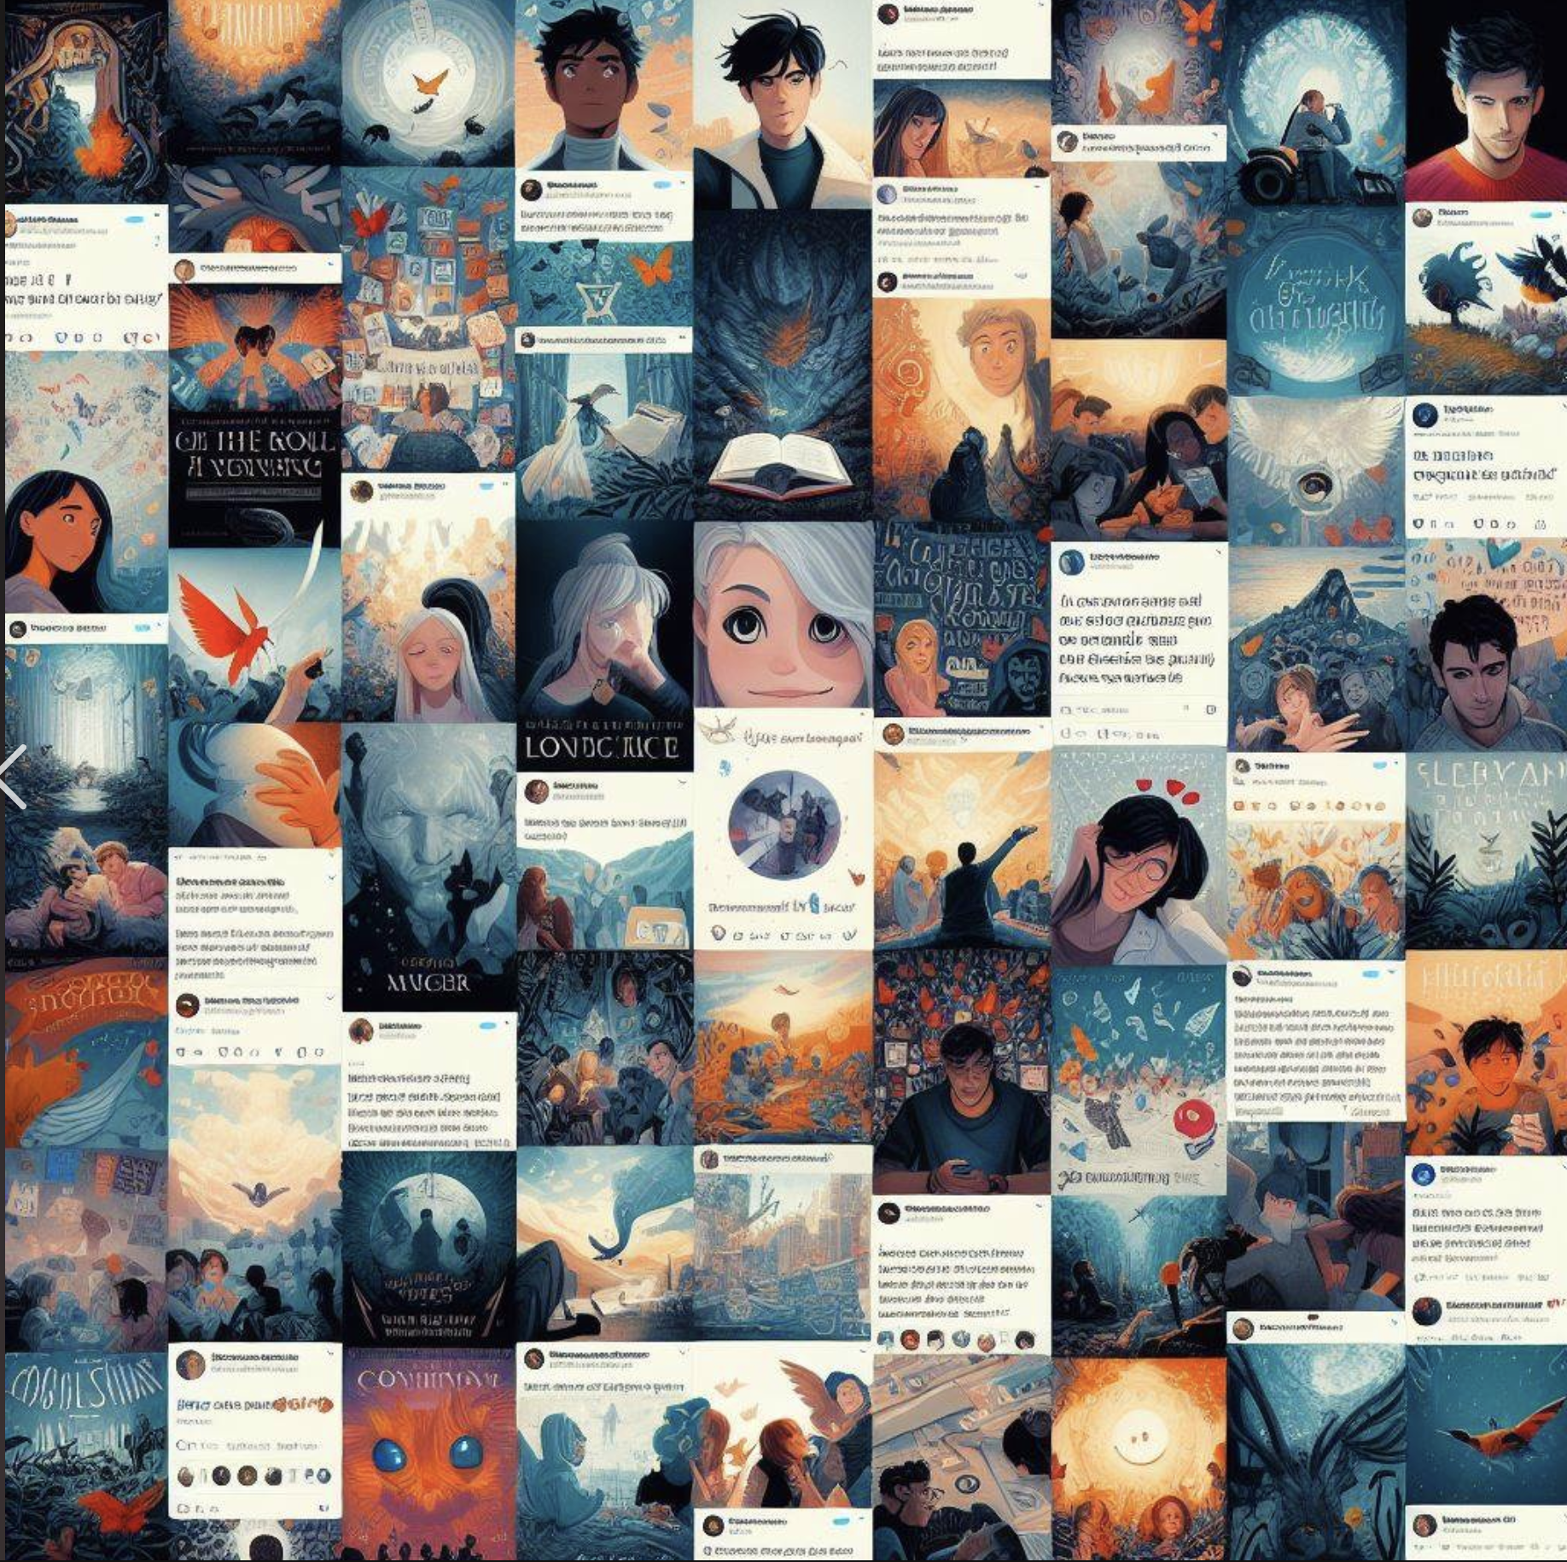

Wrap up
Notes:
We analyzed data on more than 212,404 books and 142.8 million reviews from Amazon;
tasks included understanding text mining concepts, data cleansing, sentiment analysis, and predictive modeling.
The sentiment analysis involved categorizing reviews as positive or negative and building a model to predict book ratings based on those ratings.
This improved the understanding of customer sentiment and preferences from textual data.
With this insight, we will be able to develop strategies to further increase customer satisfaction.

Slide 21
Thank you for listening

